Slide 1

LESSON 1
ABSTRACTION, SORTING & SEARCHING ALGORITHMS
CCE 105L
DATA
STRUCTURES

Slide 2

Problem Solving Process
01
02
LESSON
TOPICS
03
04

Slide 3

01
02
ABSTRACTION
LESSON
TOPICS
03
04

Slide 4

01
02
LESSON
TOPICS
SORTING
ALGORITHMS
03
04
Bubble Sort
Insertion Sort
Selection Sort

Slide 5

01
02
Linear Search
Binary Search
LESSON
TOPICS
03
04
Searching
Algorithms

Slide 6
Data Structure
is an arrangement of data in a computer’s memory (or sometimes on a disk).
Data structures include arrays, linked lists, stack and binary trees, among others.
DATA STRUCTURES AND
ALGORITHM
A data structure is a specialized format for organizing, processing, retrieving and storing data.
Data structures make it easy for users to access and work with the data they need in appropriate ways.
Algorithm
manipulates the data in these structures in various ways, such as searching for a particular data item and sorting the data.

Slide 7
Programming – is a problem-solving process.
1
Problem domain
Problem
Solving
Process
input or the raw data to process
output or the processed data
2
Machine domain
Storage medium – consists of serially arranged bits that are addressable as a unit
Processing unit – allows us to perform basic operations that include arithmetic, comparison, etc.
3
Solution domain
links the problem and machine domains. It is at the solution domain where structuring of higher-level data structures and synthesis of algorithms are of concern.

Slide 8
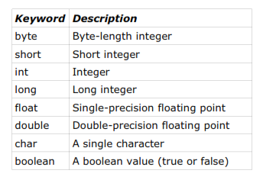
refers to the to the kind of data that variables can assume, hold or take on in a programming language and for which operations are automatically provided.
Data
Type

Slide 9
is a mathematical model with a collection of operations defined on the model. It specifies the type of data stored. It specifies what its operations do but not how it is done. In Java, ADT can be expressed with an interface, which contains just a list methods.
Abstract
Data
Type
designed by composing data elements into a logical unit representing an abstract data type that has relevance to the algorithm or application
An example of an abstract data type is a "customer name" that is composed of the character strings for "first name," "middle name" and "last name."

Slide 10
is the implementation of ADT in terms of the data types or other data structures. A data structure is modeled in Java by a class. Classes specify how operations are performed. In Java, to implement an ADT as a data structure, an interface is implemented by a class.
Data
Structure

Slide 11
is a finite set of instructions which, if followed, will accomplish a task. It has five important properties: finiteness, definiteness, input, output and effectiveness.
Algorithm

Slide 12
Five Important Properties of Algorithm
Finiteness
means an algorithm must terminate after a finite number of steps.
Output
is the set of one or more resulting quantities which is also called the range of the algorithm.
Definiteness
is ensured if every step of an algorithm is precisely defined.
Effectiveness
is ensured if all the operations in the algorithm are sufficiently basic that they can, in principle, be done exactly and in finite time by a person using paper and pen.
Input
is the domain of the algorithm which could be zero or more quantities.

Slide 13
public class Minimum {
public static void main(String[] args) {
int a[] = { 23, 45, 71, 12, 87, 66, 20, 33, 15, 69 };
int min = a[0];
for (int i = 1; i < a.length; i++) {
if (a[i] < min) min = a[i]; }
System.out.println("The minimum value
is: " + min);
}
}
DATA STRUCTURES AND
ALGORITHM
Example

Slide 14
Mathematical Functions
useful in the creation and analysis of algorithms.
Floor of x - the greatest integer less than or equal to x, where x is any real number.
Notation: └ x ┘
Example:
└ 3.14 ┘ = 3 └ 1/2 ┘ = 0 └ -1/2 ┘ = - 1
Ceiling of x - is the smallest integer greater than or equal to x, where x is any real number.
Notation : ┌ x ┐
Example:
┌ 3.14 ┐ = 4 ┌ 1/2 ┐ = 1 ┌ -1/2 ┐ = 0

Slide 15
Mathematical Functions
useful in the creation and analysis of algorithms.
Modulo - Given any two real numbers x and y, x mod y
is defined as
"-x mod n" is to find "x mod n"
Example:
10 mod 3 = 1
24 mod 8 = 0
-5 mod 7 = -5

Slide 16
└ -3.14 ┘
Answer: -4
Mathematical Functions
Example
Notes:
Answer: -4
greatest integer less than or equal to x

Slide 17
┌ -3.14 ┐
Answer: -3
Mathematical Functions
Example
Notes:
Answer: -3
smallest integer greater than or equal to x

Slide 18
┌ 5 ┐
Answer: 5
Mathematical Functions
Example
Notes:
Answer: 5

Slide 19
┌ -5 ┐
Answer: -5
Mathematical Functions
Example
Notes:
Answer: -5

Slide 20
┌-4.2┐ mod 3
Answer: -1
Mathematical Functions
Example
Notes:
Answer: -1
-4 mod 3

Slide 21
└ -4.2 ┘ mod 3
Answer: -2
Mathematical Functions
Example
Notes:
Answer: -2
-5 mod 3

Slide 22
└ 4.2 ┘ + ┌5.6┐ mod 2
Answer: 4
Mathematical Functions
Example
= 4 + 6 mod 2
= 4 + 0
Notes:
Answer: 4

Slide 23
(└ 4.2 ┘ + ┌-5.6┐) +
└ 7.2 ┘ mod 3
Answer: 0
Mathematical Functions
Example
=(4 + -5) + 7 mod 3
=-1 + 1
Notes:
Answer: 0

Slide 24
Questions?

Slide 25
Let’s have a Quiz!
Mathematical Functions

Slide 26
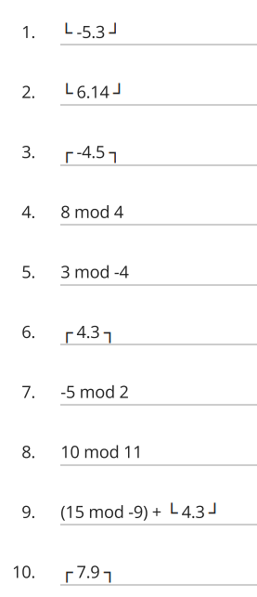
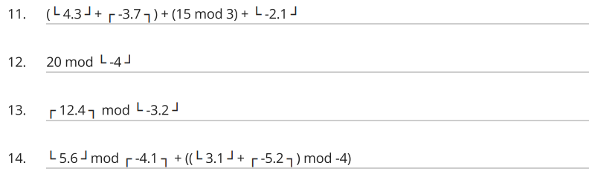
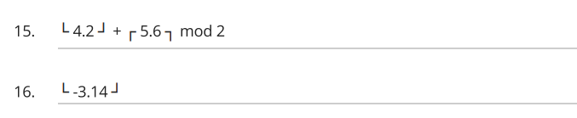
Mathematical Functions

Slide 27
Mathematical Functions
Let us answer your quiz!

Slide 28
-6
6
-4
0
Mathematical Functions
3
5
-1
10
10
8
Notes:
9. (6)+4

Slide 29
(4 + -3)+0 + -3 = -2
20 mod -4 = 0
13 mod -4 = 1
= 5 mod -4 + ((3 + -5) mod -4)
= 1 + (-2 mod -4)
= 1-2
= -1
Mathematical Functions
4 + 6 mod 2 = 4
-4

Slide 30

What Computer Program can do?
A Sorting Algorithm is used to rearrange a given array or list elements according to a comparison operator on the elements. The comparison operator is used to decide the new order of element in the respective data structure.
1 Bubble Sort
2 Insertion Sort
3 Selection Sort
Sorting Algorithms

Slide 31
Bubble Sort
- is the simplest sorting algorithm that works by repeatedly swapping the adjacent elements if they are in wrong order.
- is also known as exchange sort.
In bubble sort algorithm array is traversed from 0 to the length-1 index of the array and compared one element to the next element and swap values in between if the next element is less than the previous element.
In other words, bubble sorting algorithm compare two values and put the largest value at largest index. The algorithm follow the same steps repeatedly until the values of array is sorted.

Slide 32
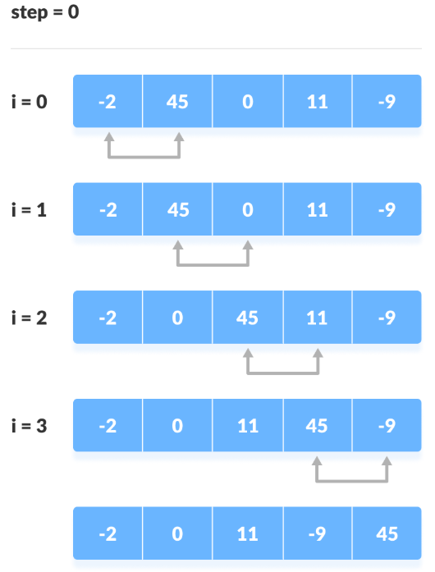
Bubble Sort
Starting from the first index, compare the first and the second elements. If the first element is greater than the second element, they are swapped. Now, compare the second and the third elements. Swap them if they are not in order. The above process goes on until the last element.

Slide 33
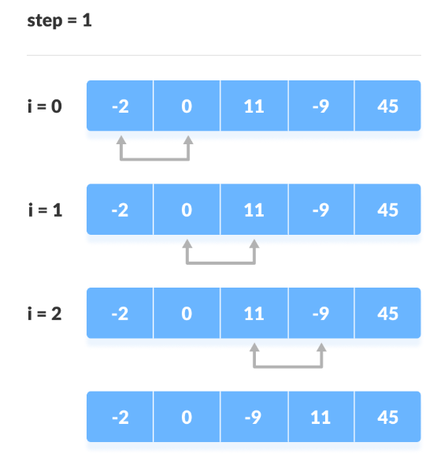
Bubble Sort
The same process goes on for the remaining iterations. After each iteration, the largest element among the unsorted elements is placed at the end. In each iteration, the comparison takes place up to the last unsorted element. The array is sorted when all the unsorted elements are placed at their correct positions.

Slide 34
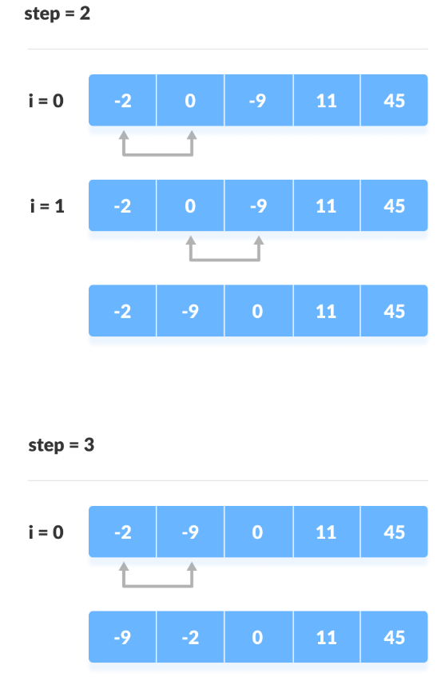
Bubble Sort
The same process goes on for the remaining iterations. After each iteration, the largest element among the unsorted elements is placed at the end. In each iteration, the comparison takes place up to the last unsorted element. The array is sorted when all the unsorted elements are placed at their correct positions.

Slide 35
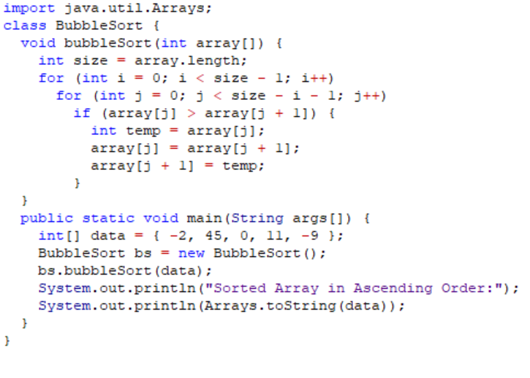
Bubble Sort
Sample
Program

Slide 36
Insertion Sort
- is a simple sorting algorithm that works the way we sort playing cards in our hands.
We assume that the first card is already sorted then, we select an unsorted card. If the unsorted card is greater than the card in hand, it is placed on the right otherwise, to the left. In the same way, other unsorted cards are taken and put at their right place.
A similar approach is used by insertion sort.
Insertion sort is a sorting algorithm that places an unsorted element at its suitable place in each iteration.

Slide 37
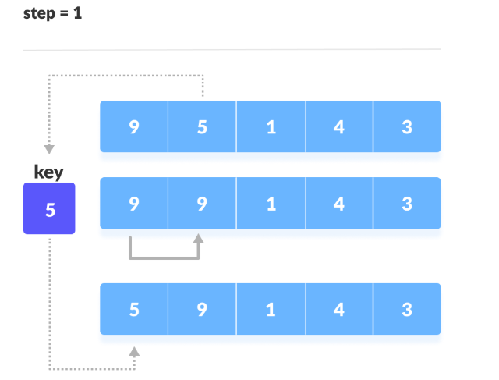
Insertion Sort
1. The first element in the array is assumed to be sorted. Take the second element and store it separately in key.
Compare key with the first element. If the first element is greater than key, then key is placed in front of the first element.

Slide 38
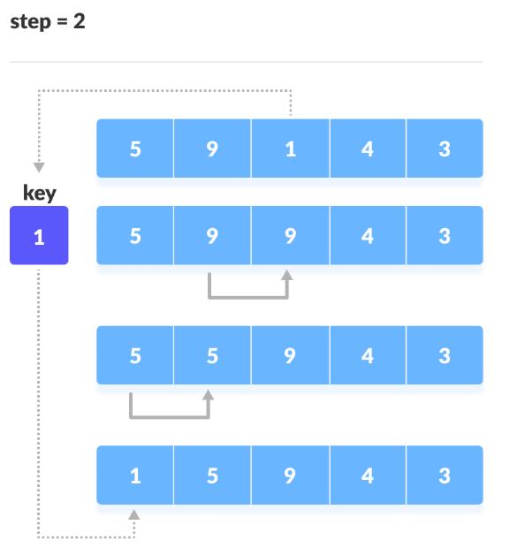
Insertion Sort
2. Now, the first two elements are sorted.
Take the third element and compare it with the elements on the left of it. Placed it just behind the element smaller than it. If there is no element smaller than it, then place it at the beginning of the array.

Slide 39
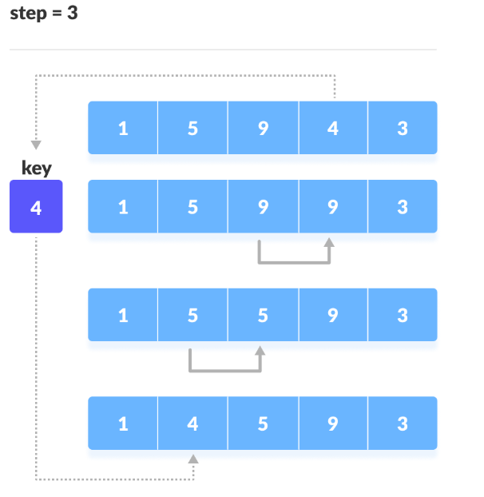
Insertion Sort
3. In a similar way, place every unsorted element at its correct position.

Slide 40
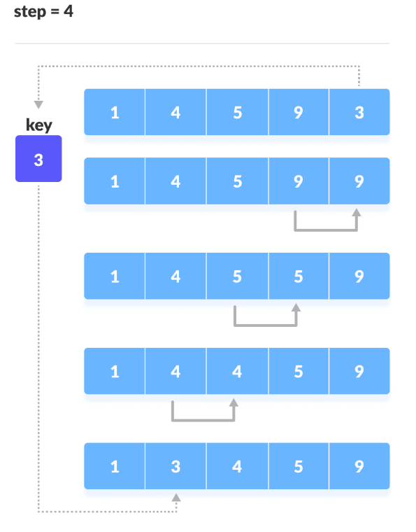
Insertion Sort
3. In a similar way, place every unsorted element at its correct position.

Slide 41
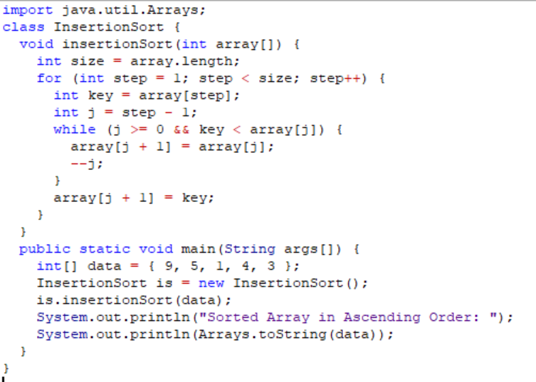
Insertion Sort
Sample
Program

Slide 42
- is an algorithm that selects the smallest element from an unsorted list in each iteration and places that element at the beginning of the unsorted list.
Selection Sort
The selection sort algorithm sorts an array by repeatedly finding the minimum element (considering ascending order) from unsorted part and putting it at the beginning. The algorithm maintains two subarrays in a given array.
1) The subarray which is already sorted.
2) Remaining subarray which is unsorted.
In every iteration of selection sort, the minimum element (considering ascending order) from the unsorted subarray is picked and moved to the sorted subarray.

Slide 43
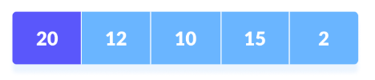
Selection Sort
1. Set the first element as minimum.

Slide 44
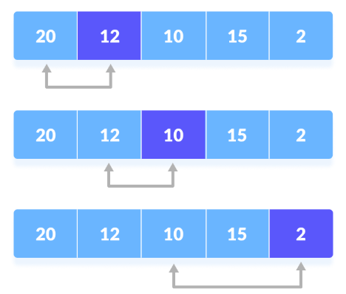
Selection Sort
2. Compare minimum with the second element. If the second element is smaller than minimum, assign second element as minimum.
Compare minimum with the third element. Again, if the third element is smaller, then assign minimum to the third element otherwise do nothing. The process goes on until the last element.

Slide 45
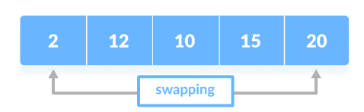
Selection Sort
3. After each iteration, minimum is placed in the front of the unsorted list.

Slide 46
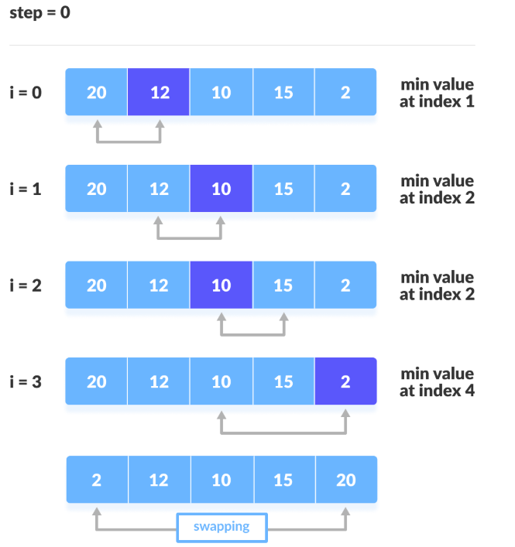
Selection Sort
4. For each iteration, indexing starts from the first unsorted element. Step 1 to 3 are repeated until all the elements are placed at their correct positions.

Slide 47
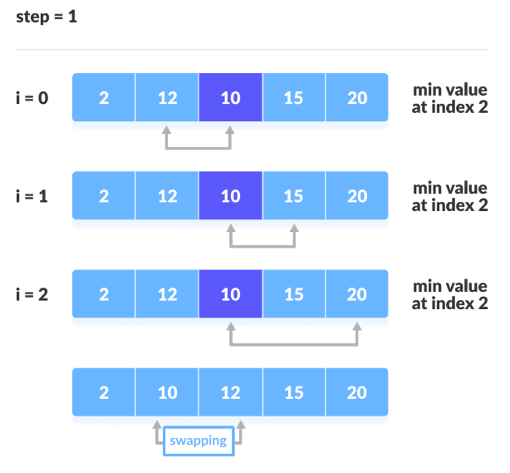
Selection Sort
4. For each iteration, indexing starts from the first unsorted element. Step 1 to 3 are repeated until all the elements are placed at their correct positions.

Slide 48
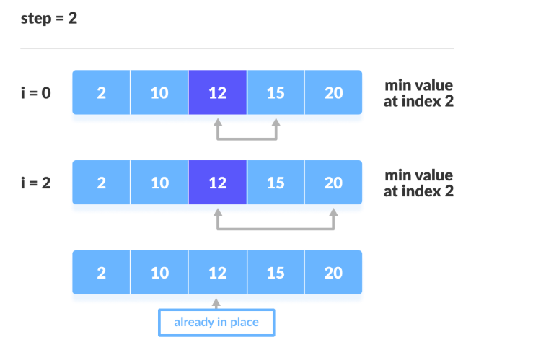
Selection Sort
4. For each iteration, indexing starts from the first unsorted element. Step 1 to 3 are repeated until all the elements are placed at their correct positions.

Slide 49
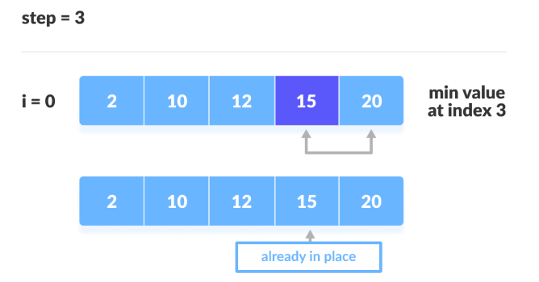
Selection Sort
4. For each iteration, indexing starts from the first unsorted element. Step 1 to 3 are repeated until all the elements are placed at their correct positions.

Slide 50
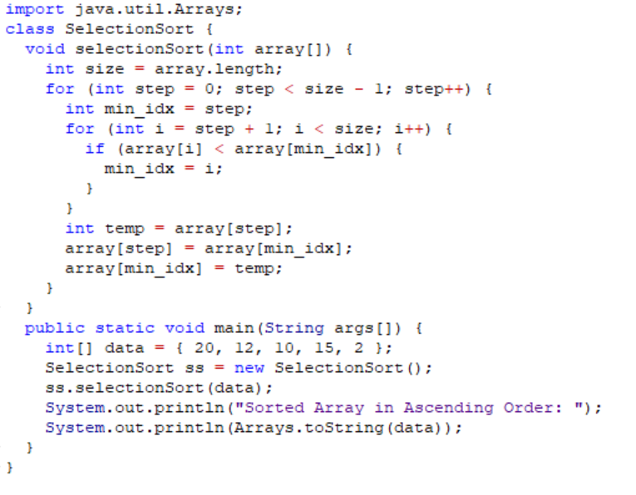
Selection Sort
Sample
Program

Slide 51
Thanks!
Questions?

